Slide 1
The Sahara Desert

Slide 2
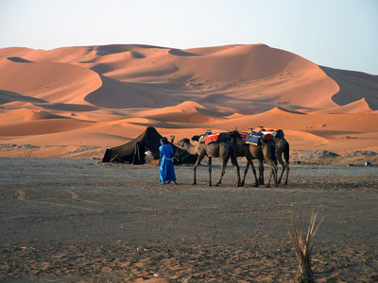
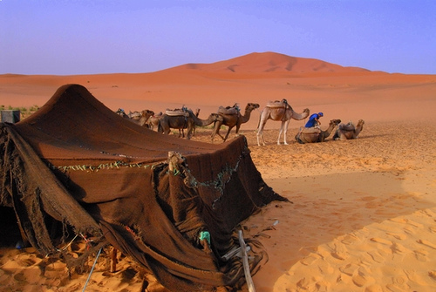

Slide 3
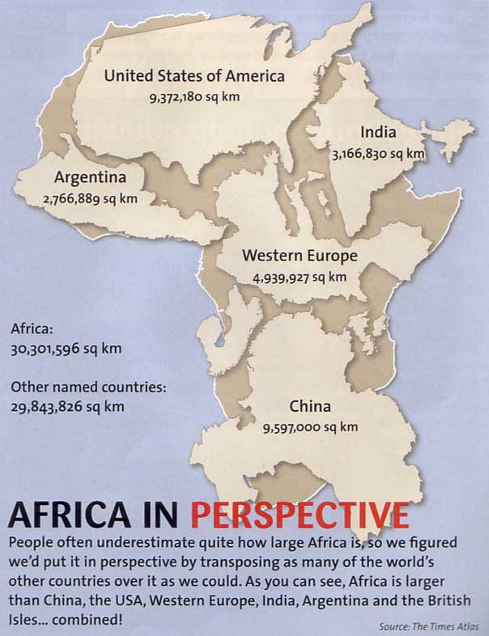
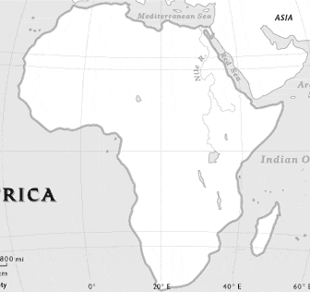

Slide 4
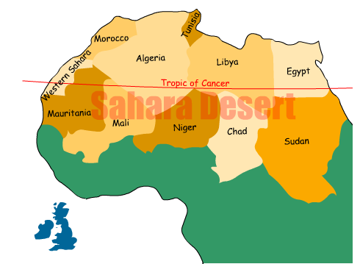
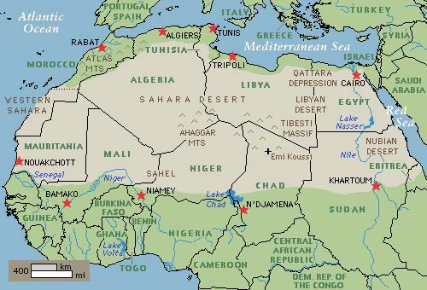

Slide 5
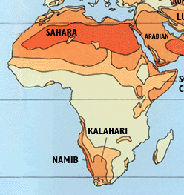
The size of the Sahara Desert is 3.3 million square miles
It covers most of North Africa.
Population of 3 million people
The Sahara Desert, due to drought, erosion, desertification and poor agricultural practices, is expanding at a rate of close to 30 miles south a year into an area called the Sahel.
African nations are trying to create a wall of forest to slow down and possibly prevent the accelerated rate of desertification.

Slide 6
Read and Say Something Conversation Starters
As you alternate reading paragraphs out loud, the listener asks a question after each paragraph.
That reminds me of…
I wonder if that is…
What do you think about…
That makes me think about…
I wonder why…
Do you think that…

