Slide 1
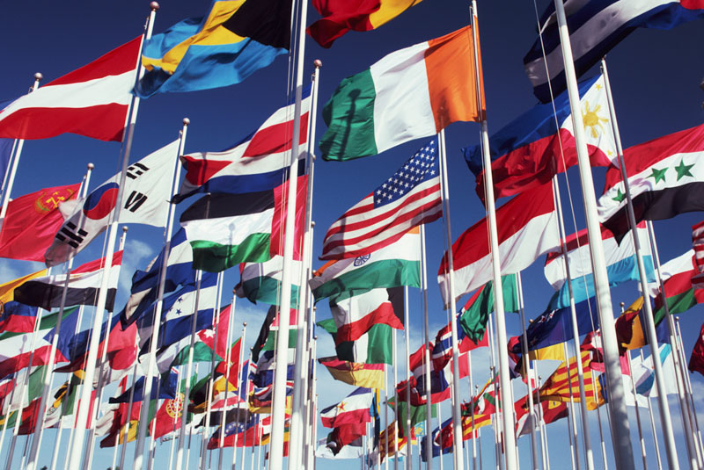
The Meaning of Culture

Slide 2
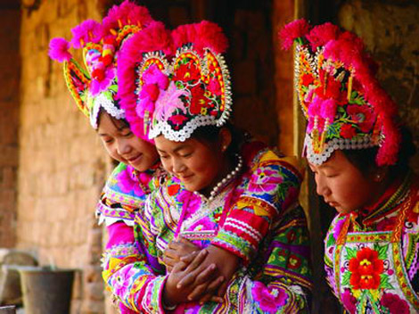
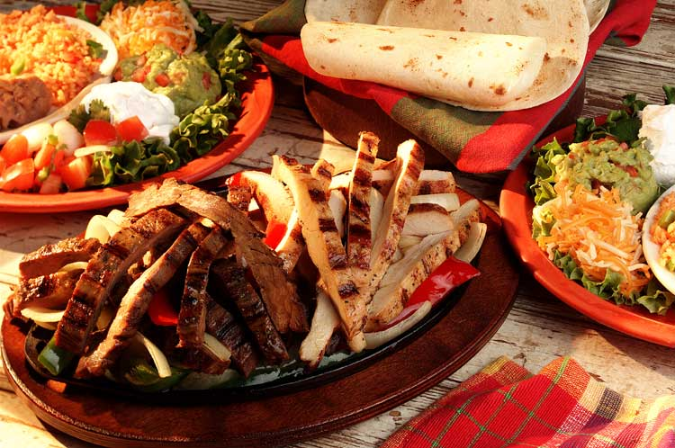
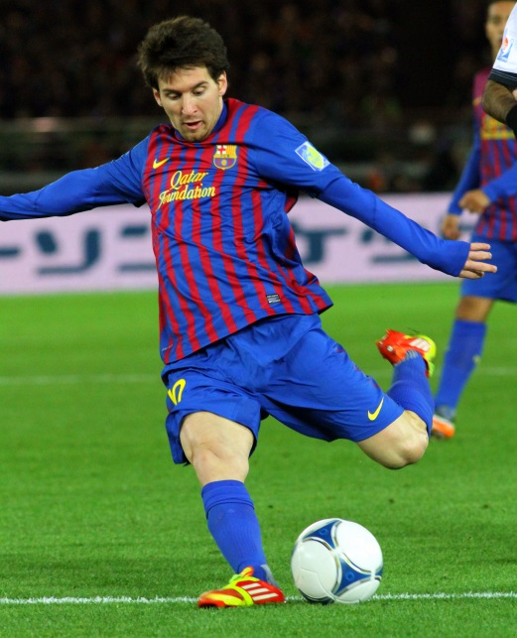
What is Culture?
All the things that make a people’s entire way of life
Food
Traditions
Education
Clothes
Music
Sports
Beliefs and values
We are born into our culture
We learn about our culture from our family
(parents, grandparents, aunts, uncles)

Slide 3
Elements of Culture
Social Organization
Customs and traditions
Language
Art, Music and Literature
Religion
Forms of Government
Economic Systems

Slide 4
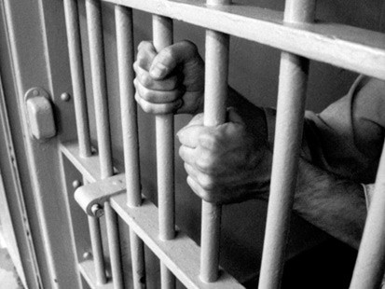
Social Organizations
Every culture creates a social structure by organizing its members into smaller units
This is done to help the people work together and meet their basic needs
Family is the most important unit of social organization
Children learn behavior expectations and belief systems
Family patterns differ throughout cultures
For the millionth time…

Slide 5
Social Organizations continued…
Nuclear Family
Includes parents and children
Typical in U.S.
Extended Family
Has several generations living in one household
Typical in farming societies and all around the world
Social Classes
A system which ranks people in order of status
Often times based on money, occupation, education, or ancestry

Slide 6
Think and Share… Take a minute to answer the following question on your own- turn to your partner and share your findings towards each question. Partner A-Come up with two reasons why extended families are less common in industrialized societies? Partner B-Do we have social classes in the United States? Examples?

Slide 7
Customs and Traditions
Rules of behaviors are one of the most important elements of a culture
These tell us how to act in certain situations
Manners, greetings, appropriate dress
Written Laws-
Each culture enforces ideas about right and wrong- more strictly than minor rules of behaviors
For example, laws against stealing or murder
What is one example of a “rule of behavior” in your family?
That awkward moment…

Slide 8
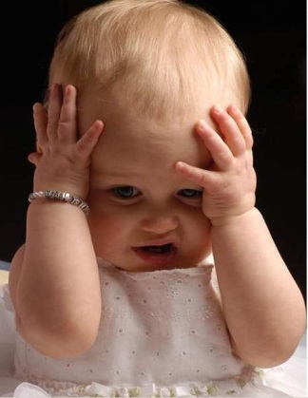
Language
Language is the cornerstone of culture
All cultures have a language
Language reflects a culture’s identity
People who speak the same language often share the same customs
Language can also present a problem
Countries which have more than one official language
Canada has 2 official languages- English and French
Many feel by giving up their language, it is the first step to giving up their culture
India has 700 languages? WHAAAT?!?

Slide 9
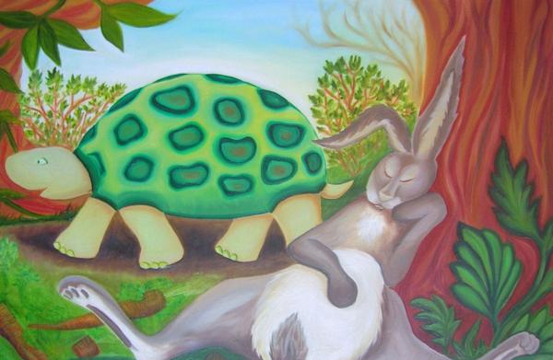
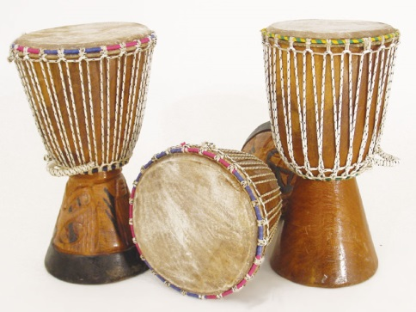
Arts, Music and Literature
Not only entertain us, but also teach us about our culture
Folk Tales are handed down from generation to generations
Help to pass on a cultures basic beliefs and values
Helps to strengthen a culture’s identity
Give a sense of belonging
Promote customs

Slide 10
Religion
Helps people answer the basic questions about the meaning of life
Helps support the values a group of people considered important
Monotheism
The worship of one god
Polytheism
The worship of more than one god

Slide 11
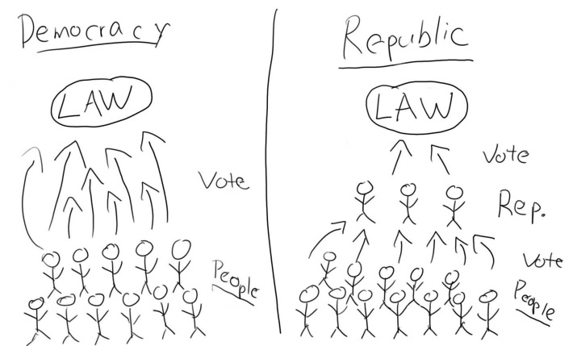
Forms of Government
People form governments to provide for their common needs
Democracy
The people have supreme power, the government cannot act without their consent
Republic
The people choose leaders to represent them
Dictatorship
A ruler or group holds power by force

Slide 12
Think and Share… Take a minute to answer the following questions on your own- turn to your partner and share your findings towards each question. Partner A-What type of government is found in the United States? Partner B- Give an example of a country today that is a dictatorship.

Slide 13
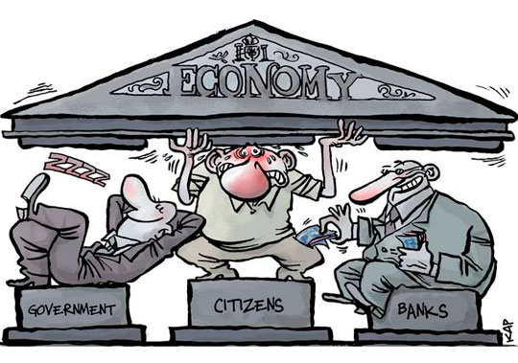
Economic Systems
Economics-how people use limited resources to satisfy their wants and needs
Traditional Economy
People produce what they need to survive
hunting and gathering societies
Market Economy
Businesses and individuals produced and sell goods for $
Command Economy
Government controls what goods are produced, how they are produced and what they cost
Mixed Economy
Individuals make some economics decisions, and government makes others

Slide 14
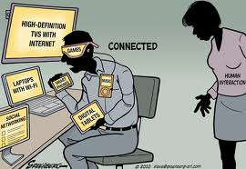
How Do Cultures Change?
Technology
skills and tools a people use
Anything from ancient tools to smart phones
Can bring both positive and negative effects of societies
Changing environment
Drought, extinction, global warming
New Ideas
Recycling, conservation

Slide 15
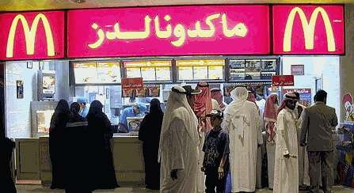
What is Cultural Diffusion?
The movement of customs or ideas from one place to another
When people migrate or travel, they exchange goods, skills, ideas and technology with the people they meet
Can occur through peaceful ways or wars
Subcultures- a group of people within a society who share certain beliefs, values and customs
What’s an example of a subculture here at HC?

Slide 16
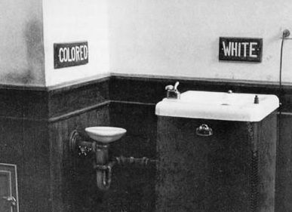
Difficult to Understand Cultures
Ethnocentrism
Judging other cultures by the standards of their own
Racism
Belief that one racial group is naturally superior to another

Slide 17
How Do We Avoid These Stereotypes?
Cultural Relativism- viewing a culture from their point of view to understand why they are doing what they’re doing.

Slide 18
Think and Share… Take a minute to answer the following question on your own- turn to your partner and share your findings towards each question. Partner A-Give two examples of Cultural Diffusion. Partner B-Give two examples of Ethnocentrism.

Slide 19
Practice
You will identify the ethnocentric perspective and then the cultural relativism perspective for the pictures on the following slide.

Slide 20
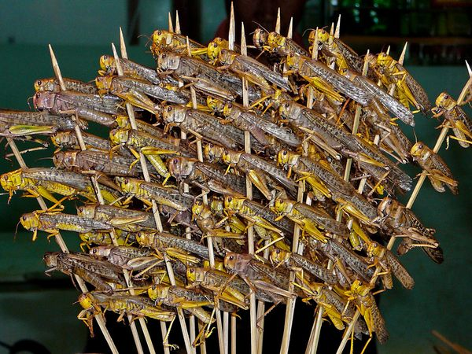

Slide 21
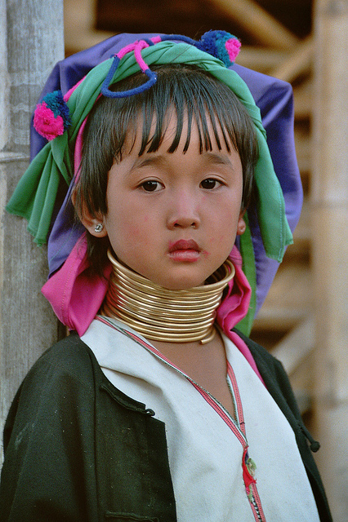
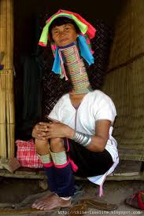
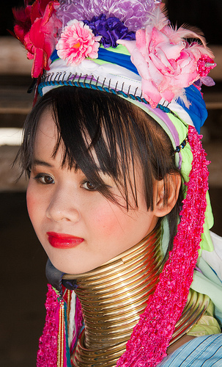

Slide 22
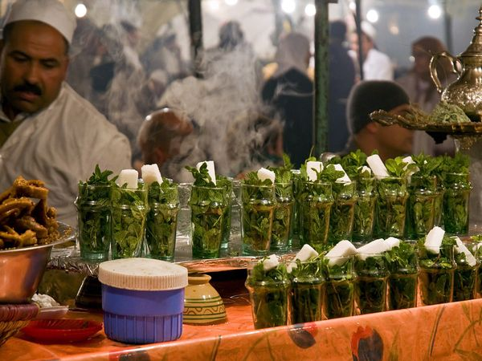

Slide 23
http://www.youtube.com/watch?v=nY-EXKzaLqc&feature=related
Massai- Kenya & Tanzania

Slide 24
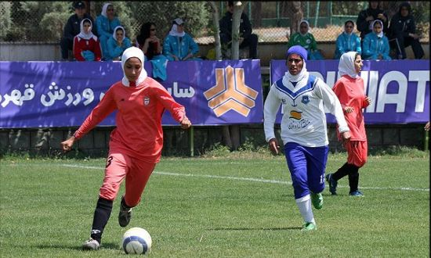

Slide 25
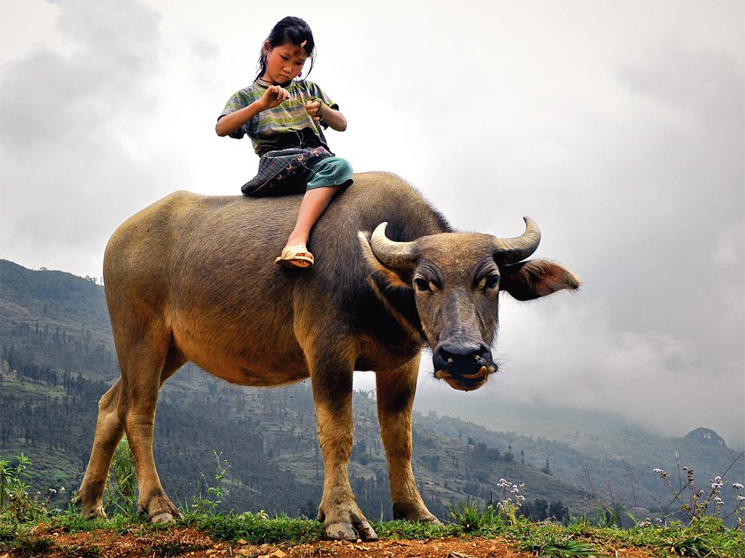

Slide 26
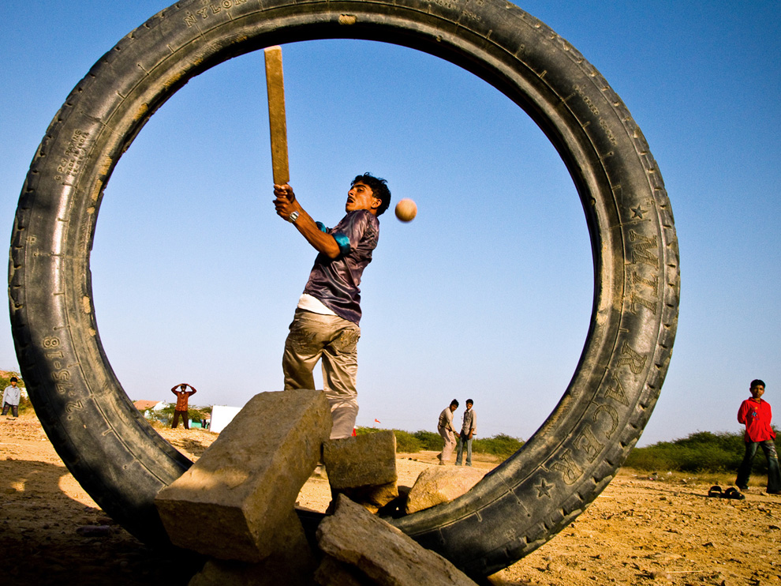

Slide 27
