Slide 1
European Imperialism in Africa

Slide 2
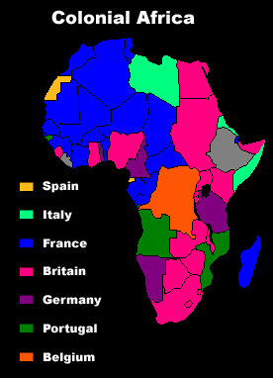
What is Imperialism?
Imperialism is the practice of a stronger country taking over a weaker country for economic gains

Slide 3
European Motives ( Why did they want to Come Africa?)
Economic
Raw material ( rubber, wood, diamonds, gold, fabric)
Political
Nationalism- pride in your country
Many nations were competing against one another in order to become more powerful
Religious
Europeans felt it was their “duty” to spread Christianity
Wanted to set up western values so the African could adopt European way

Slide 4
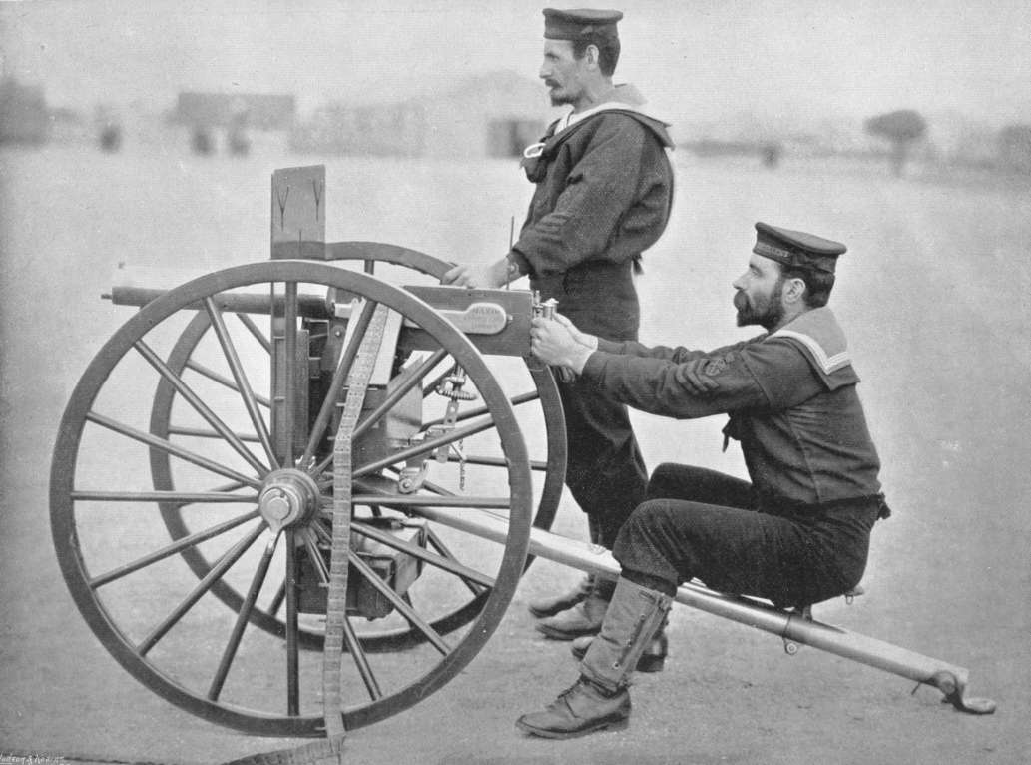
Why was it so easy for the Europeans?
New technology
Maxim gun
Medical knowledge
New medicine to fight disease like malaria
Ultimately the Africans were no match for these new inventions

Slide 5
Berlin Conference
King Leopold of Belgium and the Congo Basin
Starting trouble among European nations
Violated human rights of Africans while making them work to produce rubber and ivory
10 million are estimated to have died
14 European Nations met to divide up Africa among themselves
Ethiopia and Liberia were the only 2 nations not colonized by the Europeans
NO AFRICANS WERE INCLUDED

Slide 6
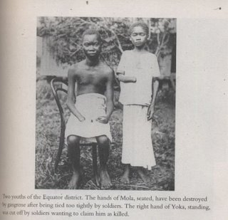
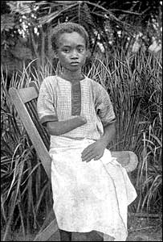

Slide 7
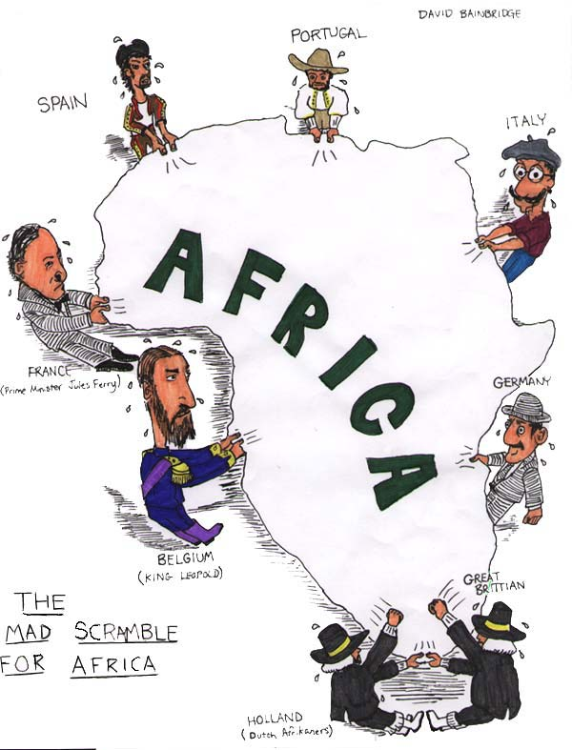

Slide 8
Effects of European Rule
New government systems
Direct Rule- European nations sent over a governor to rule
Indirect Rule-European nations left local leaders in charge
Money system
Moved from bartering to money economy
Education
Schools set up
Taught European languages and history
Educating new African leaders for the future
Transportation and Communication systems
Railroads
roads
Hospitals

Slide 9
Use the following words to create a summary on Imperialism in Africa
Imperialism Africa Colonization
Berlin Conference Economic Free nations
Political Religious Medicine
Maxim Gun Medicine King Leopold
Congo Human Rights 14
European Direct Rule Indirect Rule
Positive impacts Negative impacts

