Slide 1
Africa- Geography, People and Climate

Slide 2
Africa Basics
Africa is the 2nd largest continent and is more than three times bigger than the United States!
Africa stands between two major oceans- Atlantic and the Indian.
Most of Africa is a huge plateau

Slide 3
People of Africa
More than 866 million people live in Africa
Very diverse
Races
Religions and Beliefs
Occupations
Languages
The people of Africa speak more than 1,000 languages

Slide 4
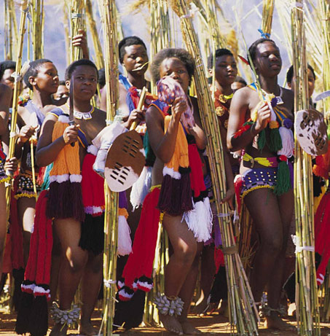
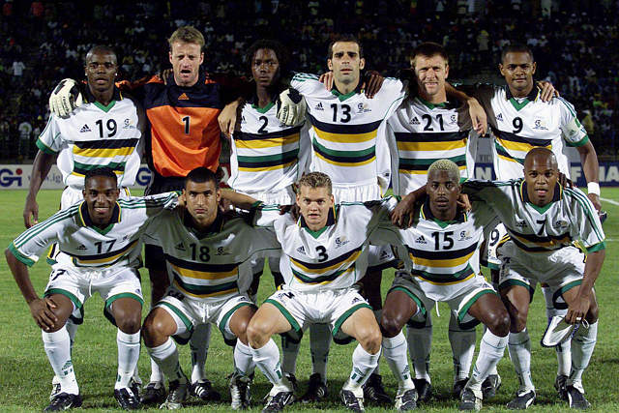
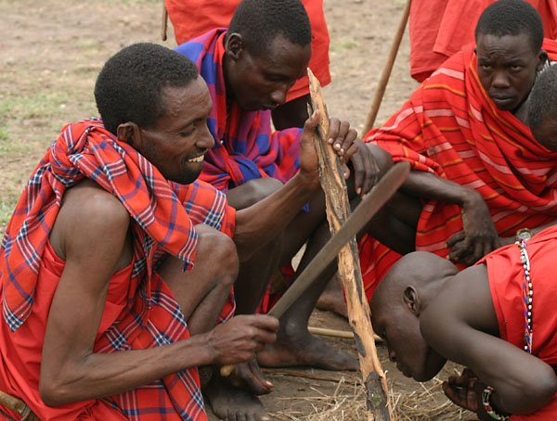
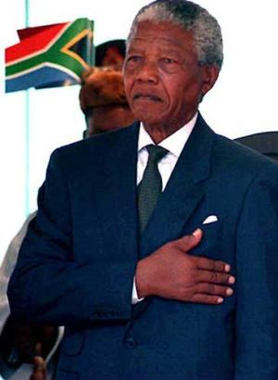
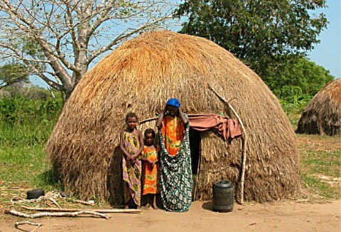

Slide 5
The Great Rift Valley
The Great Rift Valley is a large “split” in the African Continent
It extends 4,000 miles from the Middle East all the way south to Mozambique
Formed by natural forces
Erosion
Volcanoes
Shifting of the plates
Fertile farmland, deep lakes, hot springs
Scientists have found the oldest living fossil in the Great Rift Valley

Slide 6
Rivers
There are four main rivers in Africa
Nile- longest river in the world and flows towards the north
Congo- waterfalls and rapids
Niger- fishing and shipping
Zambezi- Victoria Falls
Hydroelectric power- energy produced by moving water.

Slide 7
Natural Resources
Mining
Diamonds
Gold
Cobalt
Oil
The problem with the natural resources is they are unevenly distributed!

Slide 8
Climate
Because the equator runs through the center of Africa, 80% is found in the tropics
4 major climate zones
Tropical Wet
Hot and humid all year long
Tropical Wet and Dry
Both wet and dry weather
unpredictable
Desert
Cover about 40% of Africa
Hot, dry, very little rainfall
Mediterranean
Found extreme north and south of Africa
Mild climate- cool winters, warm summers

Slide 9
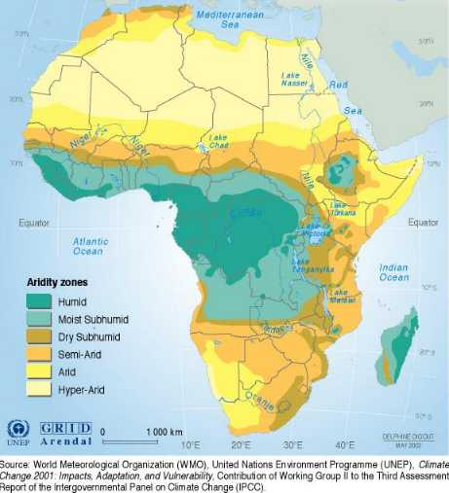

Slide 10
Savannahs
Savannahs are watered grasslands-
Fertile farmland
Over HALF of Africa is considered a savannah
Home to most Africans and many types of animals
Lions
Hyenas
Cheetahs
Gorillas
Hippos
Elephants
Wildebeest
Zebras

Slide 11
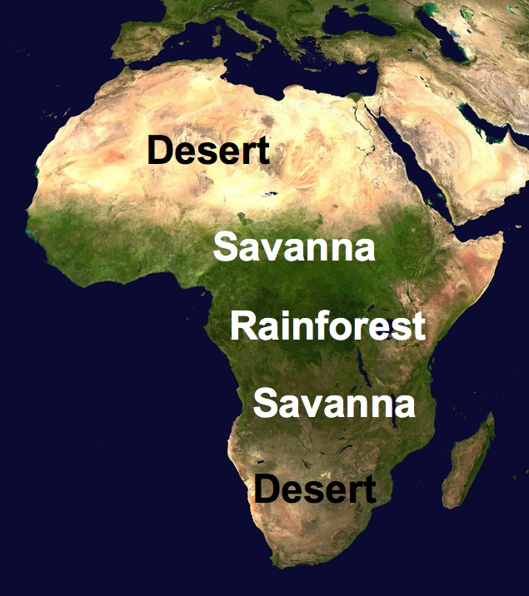

Slide 12
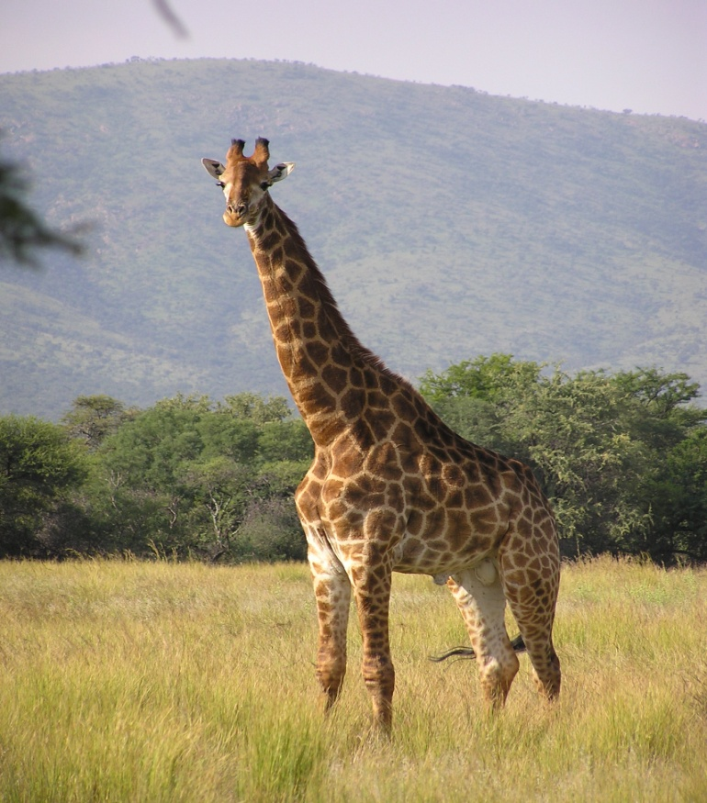
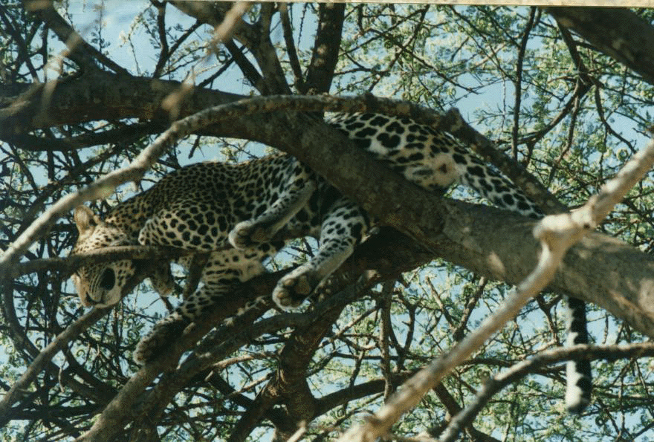
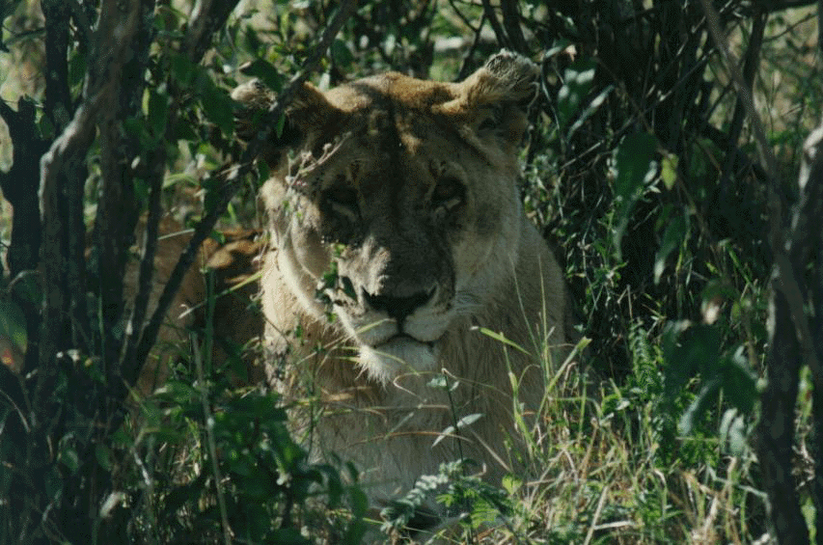
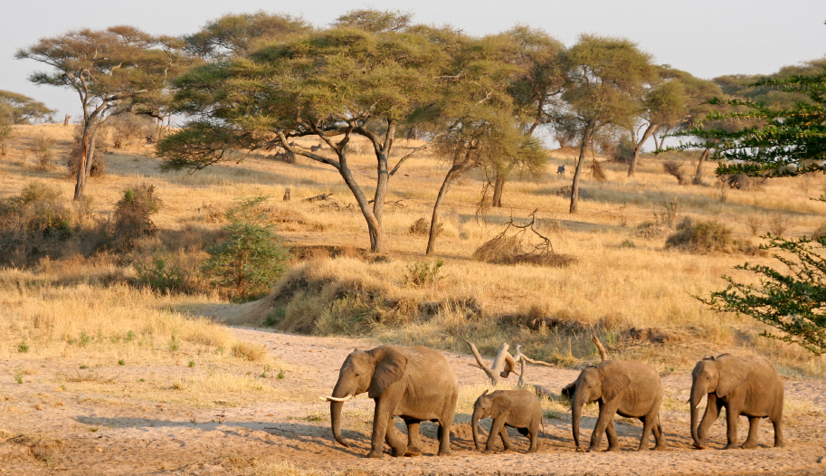

Slide 13
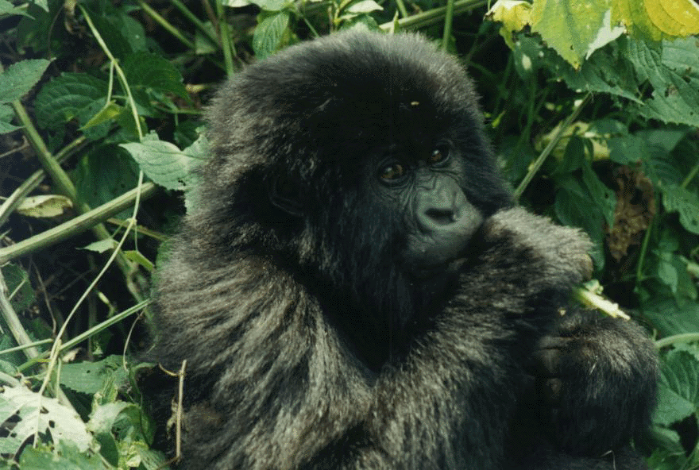
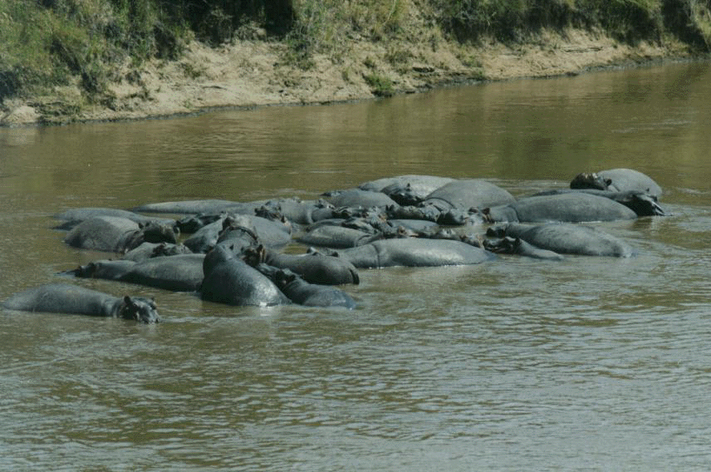
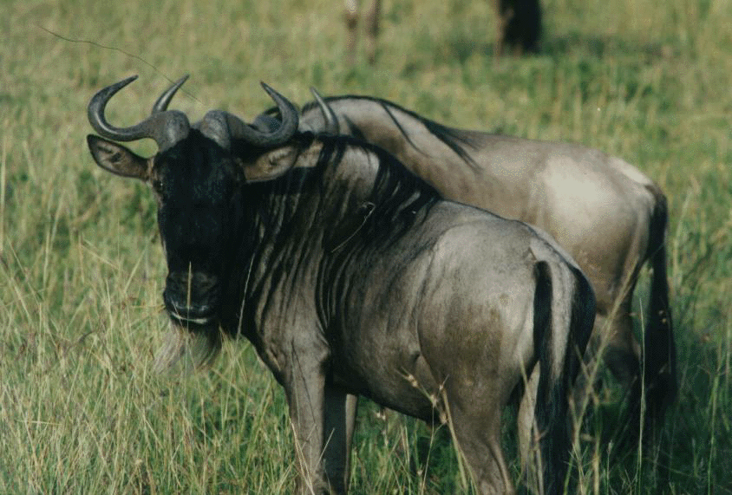
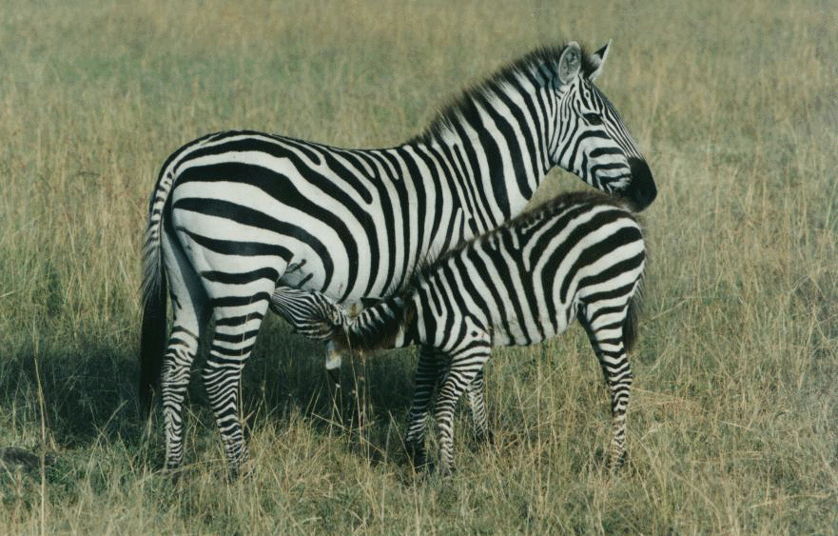

Slide 14
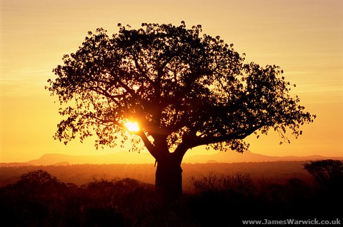

Slide 15
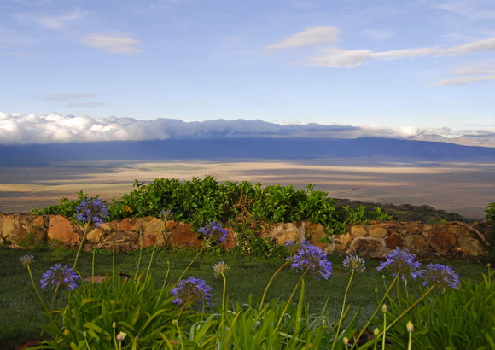

Slide 16
Problems in the Savannahs
Rainfall is very unpredictable on the Savannahs
Too much- flooding
Too little- drought
Desertification is the turning of semi-desert land into desert
Why does this happen??
Drought
Overgrazing
Human interaction
Cutting down trees

